Slide 1

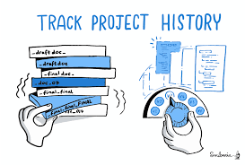


Introduction to Git and Github
By: Mr. Solomon
Danielberihun92@gmail.com

Slide 2
Learning Objectives
Version Control
Git , Git repository
Git vs Github
Setup git environment
Create a git repository ( adding file, adding folder)
Checkout different version/ignore files…
Git tools

Slide 3
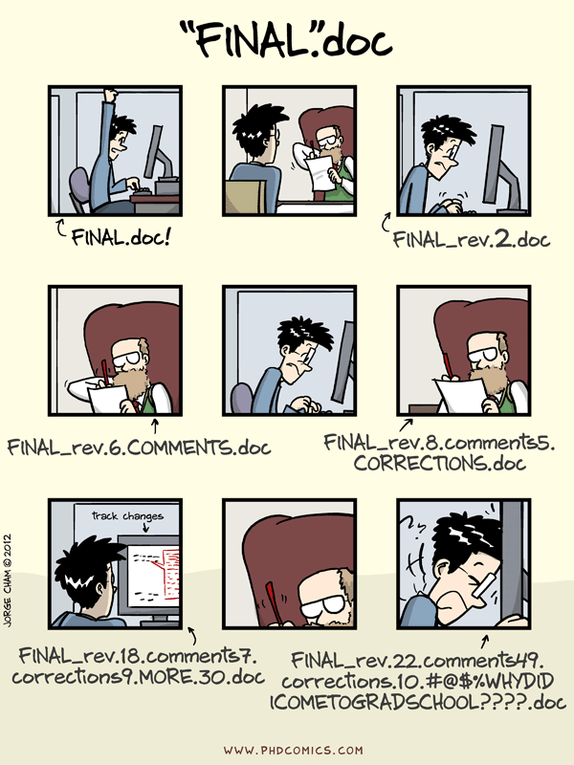
Final Final version 2
When working on essays, students spend a large portion of their time editing and revising their assignments and create multiple versions of their assignment in the process.
But these revisions may not always be satisfactory, so students have to roll back to a previous version.
The need to access previous versions of assignments requires some way to “version control” our work.

Slide 4

Why do we need Version Control?
Collaboration
Versioning
Rolling Back
Understanding
Scenario : Multiple students are working on a project together. Everybody needs to work on a section, but the whole document has to be coherent. Time is vital.
Notes:
Rollback is returning a hardware product or software program back to an earlier version after encountering issues with a later version

Slide 5
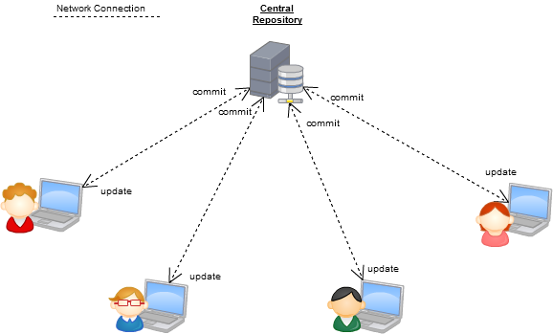
Version Control Systems
Some well-known version control systems are CVS, Subversion, Mercurial, and Git.

Slide 6

Why Git?
Git is the most commonly used software for tracking changes in any set of files, usually used for coordinating work among programmers collaboratively developing source code.
Git has many advantages over earlier systems such as CVS and Subversion:
Branching to attempt new features
Allows working offline
Tracks changes in the code
Each developer gets their own local repository that shows the full history of changes made by other developers.

Slide 7

Git History
Came out of Linux development community
Linus Torvalds, 2005
Initial goals:
Speed
Support for non-linear development (thousands of parallel branches)
Fully distributed
Able to handle large projects like Linux efficiently
Global Information Tracker (this is where the acronym GIT comes from)

Slide 8

What is Github?
GitHub.com is a site for online storage of Git repositories.
Think of it as a server that allows you to share your git projects with people around the world.
Question: Do I have to use Github in order to use Git?
Answer: No!
you can use Git completely locally for your own purposes, or
you or someone else could set up a server to share files, or
you could share a repo with users on the same file system.

Slide 9
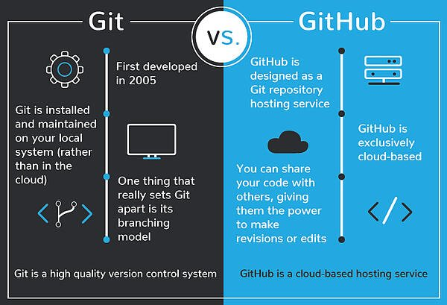
Git vs GitHub

Slide 10
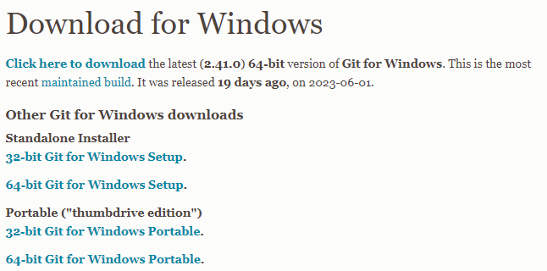

Downloading and Installing git
https://git-scm.com/download/win

Slide 11


Best code editor
https://code.visualstudio.com/download
Best git related extension on vscode

Slide 12
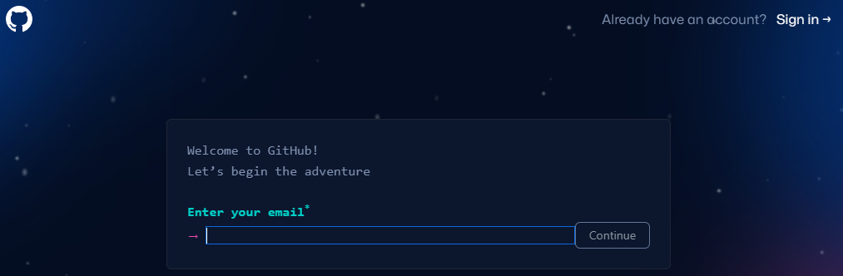
Joining Github https://github.com/signup
Notes:
Creating a new repo on github
https://docs.github.com/en/repositories/creating-and-managing-repositories/creating-a-new-repository
Pushing our local repo to github
https://docs.github.com/en/migrations/importing-source-code/using-the-command-line-to-import-source-code/adding-locally-hosted-code-to-github#adding-a-local-repository-to-github-using-git

Slide 13
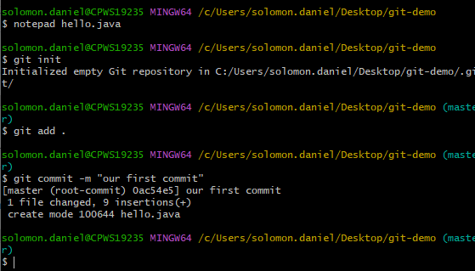
Creating a local Git repo
Go to your desktop and create a folder called “git-demo”
Open the notepad and write code for a simple hello world java class.
Open git bash within the folder and type:
git init // initializes git, and sets the location as a git repository
git add . // adds all existing files to the staging area
Git commit –m “first commit” // commits or saves the contents of the staging area to the local repo

Slide 14
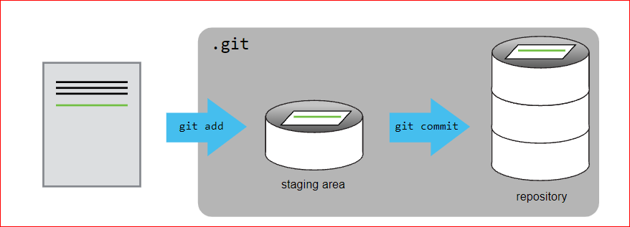
Adding a file to git repository
Notes:
git reset <filename> // unstages the file before commit
Git reset // unstages everything that has not been committed yet

Slide 15
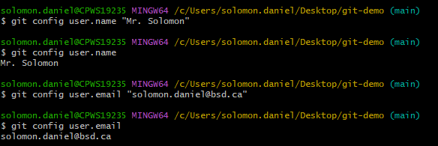
Setting your username and email for git
Git associates each commit with a user that has a user.name and a user.email
git config user.name “Mr.Solomon”
// sets the user name
git config user.name
// shows the current username
git config user.email “solomon.daniel@bsd.ca”
// sets the email
git config user.email
// shows the current user email
Notes:
Benefit of the –global parameter:
The global git username and email address are associated with commits on all repositories on your system that don’t have repository-specific values.
To set your global commit name and email address run the git config command with the --global option:
git config --global user.name "Your Name“
git config --global user.email "youremail@yourdomain.com"

Slide 16
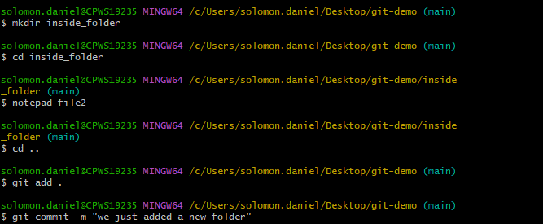
Adding and committing a folder
Adding and committing a folder is the same as adding and committing a file, but folders can not be empty.
mkdir inside_folder // makes a new folder called inside_folder
cd inside_folder //enters the new folder
notepad file2 // creates a new txt file called file2
cd .. //exits the new folder
git add . // adds everything including the new folder and its contents to the staging area
Notes:
git log --graph --oneline –all // shows the commits as a tree

Slide 17
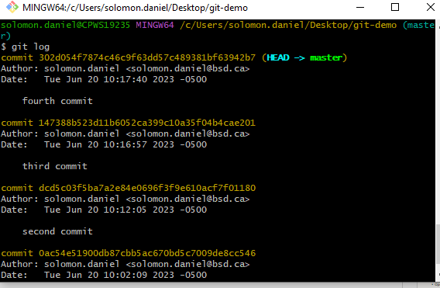

Using git log and git status
Add the edit file to the staging area and commit it a number of times, then type
git log //shows the history of commits to the repo. Note: Press q to leave the log view
git status // shows the status of your files in the working directory and staging area
Notes:
git log --graph --oneline –all // shows the commits as a tree

Slide 18
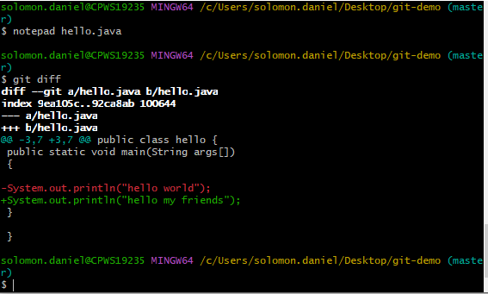
Using git diff
Open the hello.java file and change the message.
Then without adding the file to the staging area or committing, type:
git diff // shows you the new changes that have not yet been added to the staging area or committed to the repo

Slide 19

Commits

Slide 20
Git reset - -hard <Commit you want return to>
Given three commits
Commit3
Commit2
Commit1
If you want to delete commit3 and return to commit2 use:
Git reset - - hard commit2 // deletes commit3 and its changes in the files
Notes:
Given three commits
Commit 3
Commit 2
Commit 1
If you want to delete commit 3 and return to commit two use:
Git reset –hard commit2 // resets to commit 2
If you do not used the –hard option, the commit will be deleted, but the changes made to the file will still be there
https://www.youtube.com/watch?v=IWR24Z1yp80&ab_channel=JavaHomeCloud

Slide 21
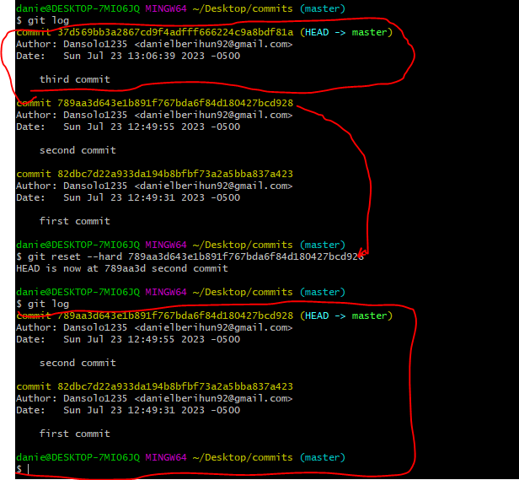
Notes:
Git reset --hard commit2 //deletes commit3 and removes it changes from the file
Git reset commit2 // deletes commit3, but keeps its changes in the file which then have to be staged and committed.

Slide 22

Git revert <unwanted commit>
Given three commits
Commit3
Commit2
Commit1
If you want to get rid of the changes created by commit3, you can use git revert commit3 which will create a new commit that is identical to commit2.
This way the number of commits increases, commit3 is still there, but the leading commit will be similar to commit2.
Notes:
Git revert <unwanted commit>
Creates a new commit which is similar to the commit before the unwanted commit.

Slide 23
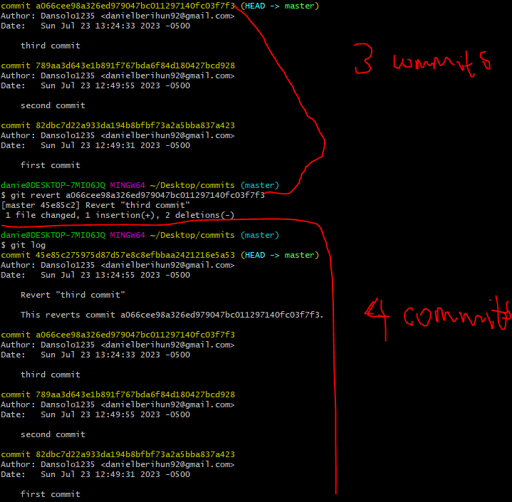
Notes:
https://www.youtube.com/watch?v=IWR24Z1yp80&ab_channel=JavaHomeCloud

Slide 24
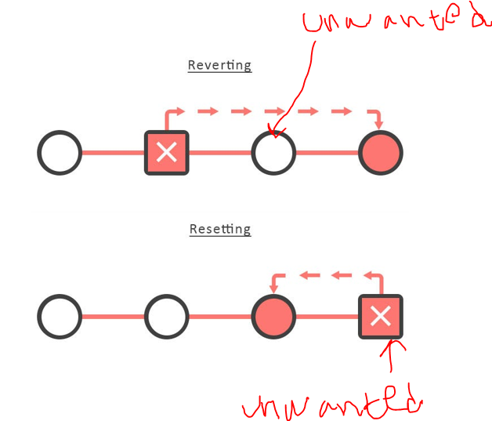

Slide 25
Git reset –hard <To>
returns to a previous commits and gets rid of all newer commits
Git revert <Unwanted>
creates a new commit that basically jumps over the unwanted commit

Slide 26
When to use git reset vs git revert
Git reset reduces the number of commits, so use it if you’re only working on a local repo so that the reduction in the number of commits does not affect any remote repo which other people may be using.
Git revert increases the number of commits which is fine for both local and remote repos. The unwanted commit is still there for people to go back to.
In conclusion:
git revert is better because it gives you the option to go back to the unwanted commit and does not hurt remote repos.

Slide 27
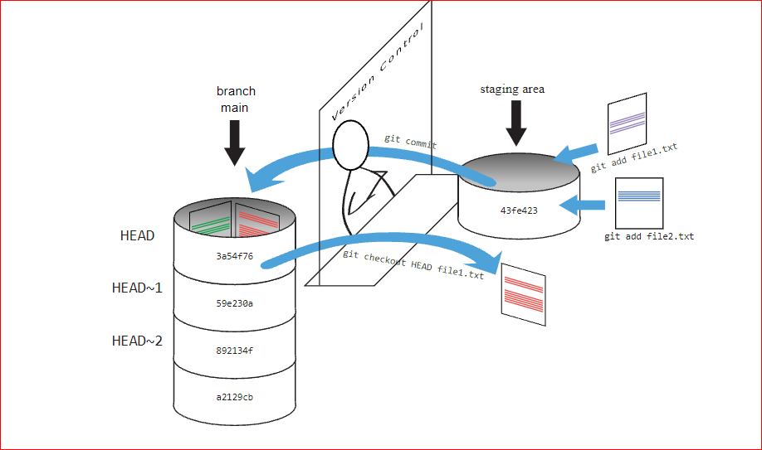

Slide 28
Other git commands
command | description
git clone url [dir] | copy a git repository so you can add to it
git add files | adds file contents to the staging area
git commit | records a snapshot of the staging area
git status | view the status of your files in the working directory and staging area
git diff | shows diff of what is staged and what is modified but unstaged
git help [command] | get help info about a particular command
git pull | fetch from a remote repo and try to merge into the current branch
git push | push your new branches and data to a remote repository
others: init, reset, branch, checkout, merge, log, tag

Slide 29

Branches

Slide 30
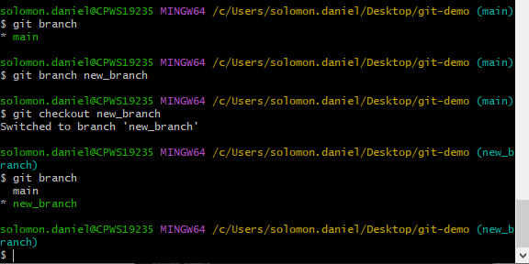
Creating and viewing branches
git branch //shows all the branches in the local repo
git branch new_branch // creates a new branch called new_branch
git checkout new_branch // lets you checkout i.e., go to new_branch

Slide 31
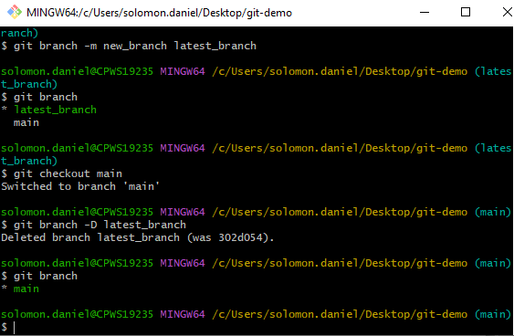
renaming and deleting branches
git branch –m new_branch latest_branch
// renames new_branch as latest_branch
Now, in order to delete latest_branch, we must get out of it first!
git checkout main // moves us to the main branch
git branch –D latest_branch // deletes latest_branch
git branch // shows all the available branches.
Notes:
For later on: local and remote branches must have the same names for git and github to work together seamlessly

Slide 32
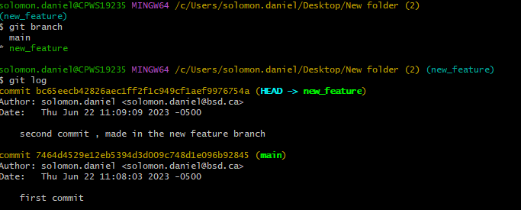
Merging branches
Make a first commit in the main branch.
Then create a new_feature branch and make a second commit there.
Then use git log to see the commit log.
We are going to merge those two branches in the next slide.

Slide 33
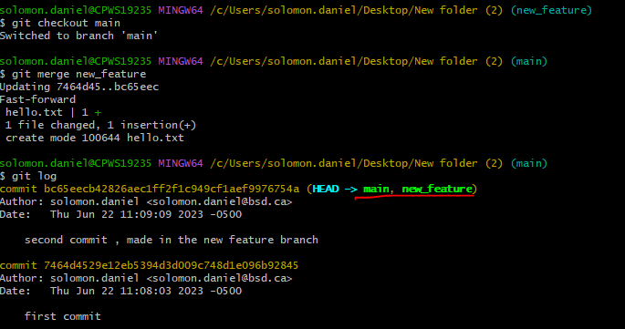
Merging branches
We want to merge the new_feature branch INTO the main branch.
To do that we: we go to the branch we want to merge INTO.
Then type git merge <branch> where <branch> is the branch you want to merge FROM.
git checkout main // moves to the main branch
git merge new_feature // merge the new feature branch into the main branch
git log // shows the commit log, notice the second log made in the new_feature branch being merged with the first commit initially made in the main branch.

Slide 34
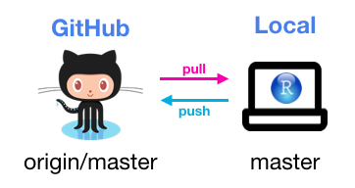
Github allows us to have a remote repository that multiple developers can copy unto their computers. This allows for remote collaboration as well version control.
In this picture:
Origin is a nickname for the remote repository on github
Master is the name of the branch in the github repo. (github has recently changed “master” to “main”)
There is also a local branch in the developer’s computer that was pulled from the remote server. (having remote and local branches with the same name is vital for consistency and ease of work)

Slide 35
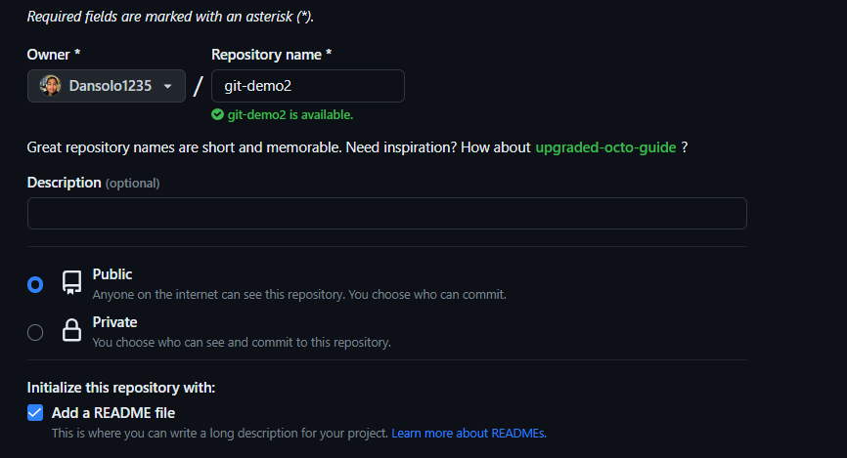
Creating a remote repo on Git hub
Log into your github account and create a repository called git-demo2.
Add a read me file and a generic license

Slide 36
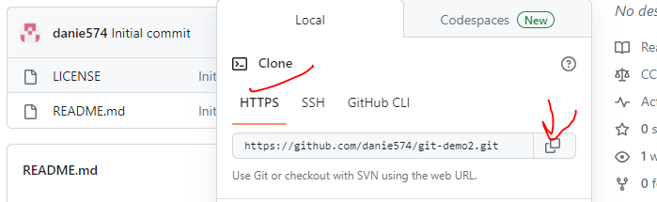
Connecting local git repo to remote github repo
Copy the Https url that refers to the remote repo.
Notes:
Whether private or public repo, using https is less hassle than using ssh.
Ssh is not covered in this course, and https is secure enough for our purposes.

Slide 37

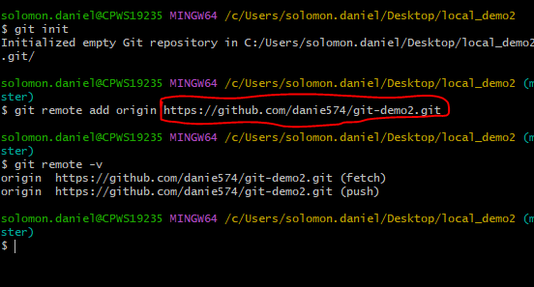
Continued
Create a folder on your computer and name it local_demo2
Inside the local_demo2 folder, open gitbash and type:
git init // initializes git, and sets the location as a git repository
git remote add origin <url> // sets the url of the remote repo into the word origin
git remote -v // shows the remote urls that will be used for pushing and pulling

Slide 38

Pulling vs cloning
Pulling a remote branch, updates the local branch with any new changes that may have been added to the remote branch.
Cloning on the other hand, is more like downloading the entire remote repository and saving it on your computer as a folder.
Pulling a branch -> updates the local branch
Cloning a repo -> downloads the repo
Create a new folder on your desktop called Clone_repo
Notes:
git pull origin main
// main here is the remote branch being pulled you can pull from any branch if you have the https link

Slide 39
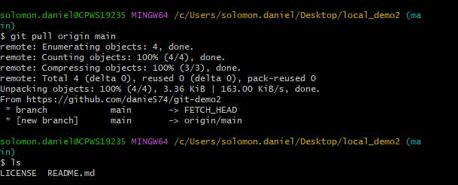
Pulling from a remote repo/branch
To pull down the Readme and license files in the remote repositiory, type the following:
git remote add origin <url> // sets the url of the remote repo into the word origin
git pull origin main // origin is a nickname for the remote repo, main is the remote branch being pulled
ls // lists the files in the folder
Notice license and readme were pulled from the remote branch.
Notes:
git pull origin main
// origin here is the remote branch being pulled you can pull from any branch if you have the link

Slide 40
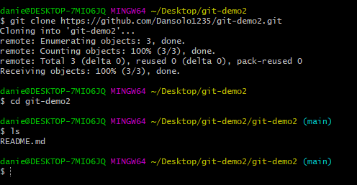
Cloning creates a local copy of the remote repo
Go into the Clone_repo folder and type:
git clone <url> // downloads the entire remote repo along with its branches.
cd git-demo2 // enters the downloaded repo
Notes:
Notice that if you clone a repo, you do not need to use
Git remote add origin <url>
Cloning a repo, allows you to create a local copy of the remote repo.
To read any public repo by cloning or pulling, you just need the https code.
To write into a public repo, you need the Personal Access Token of the account which owns it.

Slide 41

Anybody can pull or clone a public repo
Anybody can pull or clone a public repo, but if you want to push your changes to a repo, you must own the repo or be granted permission by the owner.
Create a personal access token in your github account to push into your repos from anywhere.

Slide 42
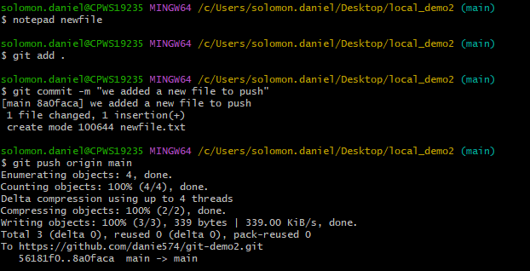
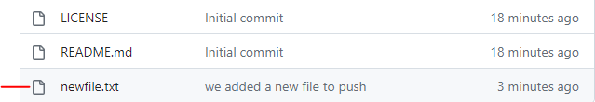
Pushing into a remote branch
To push into a remote branch, the current local branch has to have the same name. (Do you remember how to change a branch name?)
Luckily for us, our local and remote branches have the same names already.
Create, add, and commit a newfile then
Type:
git push origin main // origin is a nickname for the remote repo, main is the remote branch being updated
Now check your github repo, you will see the new file uploaded.
Notes:
Notes to remember:
git push -u origin localbranch_name // here you're creating a new remote branch which has the same name as the local branch . the local and remote branch must have the same name to enable pushing
// The -u parameter is only needed if no remote branch has the localbranch_name, in this case, a new remote branch will be created by the addition of -u parameter.
// if the local branch already has the name of the remote branch you can simply use
git push origin same_name_of_remote&local_branches

Slide 43
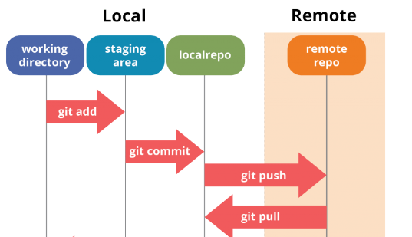
Overview of the relationship between Git and Github
Git is local
Github is remote

Slide 44
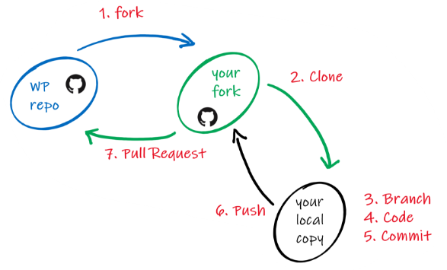
Future topics: How to fork a github repository and make pull requests.
Notes:
Try the Utility library group project

Slide 45

The end
Thank you for attending this presentation.

